Slide 1
Predicting Used Car Prices Using Machine Learning Internship Project
Hemant Kumar KB
Date: 03/12/2025

Slide 2
Project Overview
Built a machine learning model to estimate used car prices
Client: Used car marketplace
Purpose: Improve pricing accuracy using vehicle data
Outcome: Random Forest selected as final model (R² = 0.65)

Slide 3
Business Problem
Used car pricing is inconsistent and difficult
Many factors affect price (brand, age, usage, market trends)
Manual pricing leads to errors
Need an automated, data-driven pricing system

Slide 4
Project Objectives
Predict price based on car features
Understand key factors affecting price
Build a complete ML pipeline
Compare Decision Tree & Random Forest
Provide insights for better decision-making

Slide 5
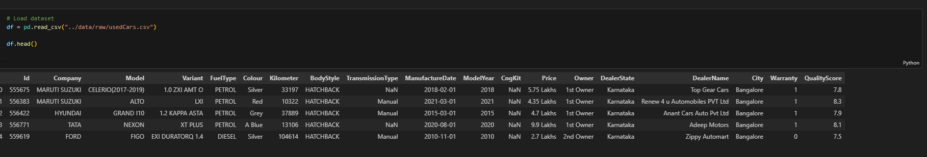
Dataset Summary
Total records: 1064
Key features:
Brand, Model
Fuel Type, Transmission
Body Style
Kilometer driven
Model Year
City / Dealer State
Quality Score
Target variable: Price

Slide 6
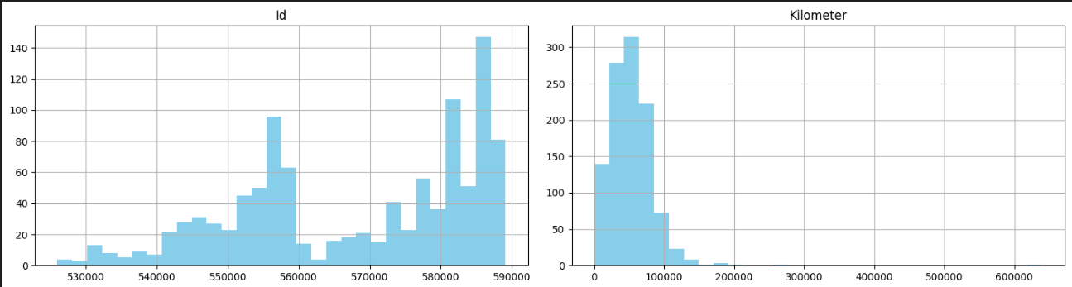
EDA Highlights
Price is right-skewed
SUVs & MUVs have higher prices
Newer cars have higher resale value
Higher kilometers → lower price
Premium brands show higher price patterns

Slide 7
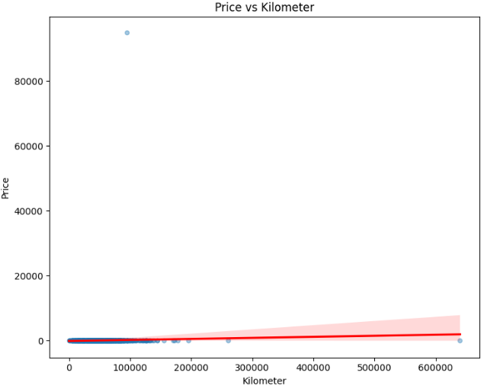
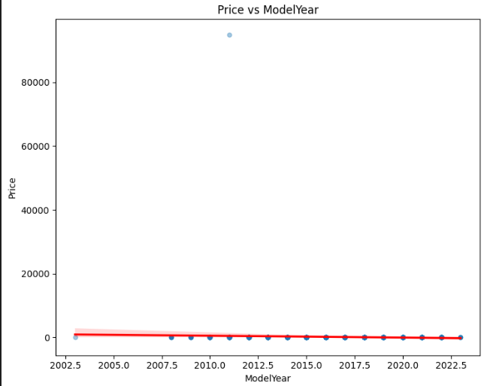
Key Visual Insights
Model Year shows upward trend
Mileage has negative impact on price

Slide 8
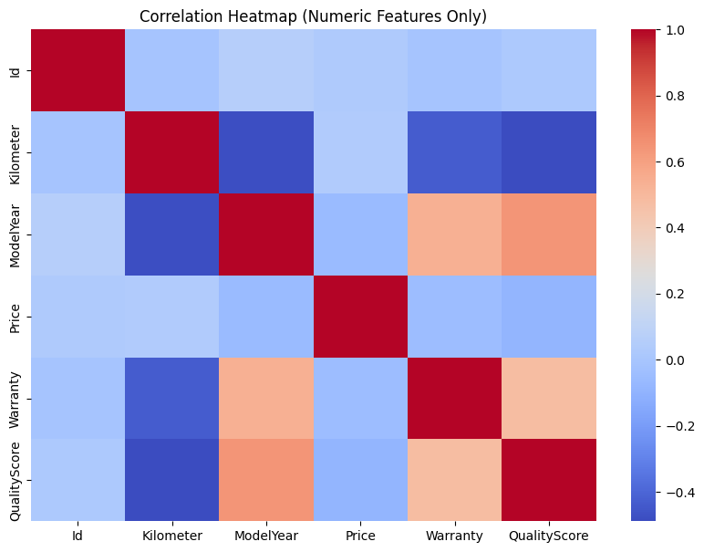
Correlation & Trends
Price correlates with ModelYear, BodyStyle, Kilometer
Weak correlation with some categorical dummy variables
City/DealerState show moderate impact

Slide 9
Data Preprocessing
Handled missing values
Cleaned numeric fields
Converted price from lakhs to rupees
Removed extreme outliers (above ₹50 lakh)
Encoded categorical variables
Prepared final cleaned dataset
Feature Engineering
Created Car Age = Current Year – Model Year
Removed unneeded columns (Id, etc.)
Extracted important features using Random Forest
Final dataset fully numeric & ready for ML

Slide 10
Model Building
Models used:
Decision Tree Regressor
Random Forest Regressor (Final Model)
Workflow:
Train-test split (80–20)
Model training
Evaluation using MSE, MAE, RMSE, R²

Slide 11
Model Performance
Metric | Decision Tree | Random Forest
MSE | 1.54e11 | 9.89e10
MAE | 2.26e5 | 1.72e5
RMSE | 3.92e5 | 3.14e5
R² | 0.46 | 0.65
Random Forest performed best
More stable & accurate predictions
Selected as final model

Slide 12
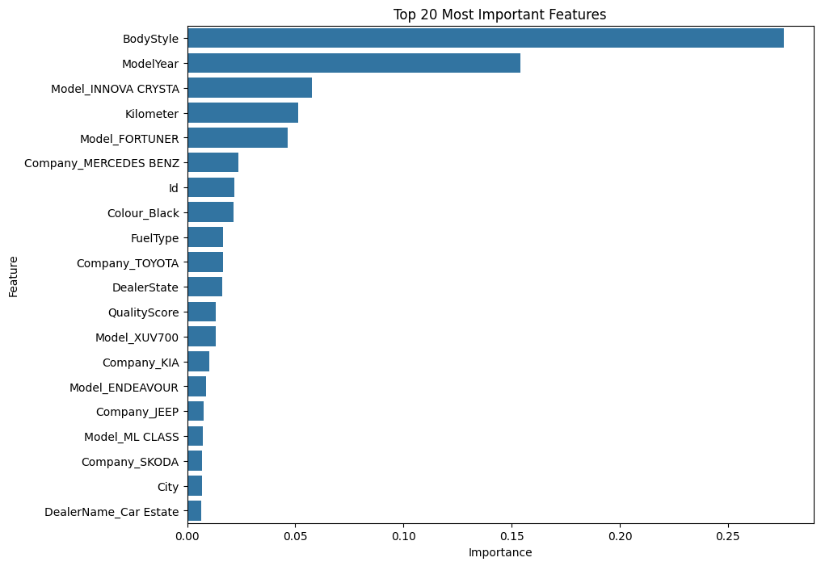
Feature Importance
BodyStyle, ModelYear, Kilometers have highest impact
Premium model names (e.g., Innova Crysta, Fortuner) also important
Fuel type & transmission influence price

Slide 13
Business Impact
Accurate price estimation builds trust with users
Dealers get better inventory insights
Helps platform maintain consistent pricing
Supports negotiation and decision-making
Overall better user experience

Slide 14
Conclusion
Built a complete ML-based price prediction system
Random Forest achieved 65% accuracy
Identified key factors influencing price
Delivered insights + model + cleaned dataset
Thank You

